Slide 1
WMU
Women’s Missionary
Union

Slide 2
WMU has…
A Heart for Missions

Slide 3
WMU is…
A women’s organization that studies, organizes, and conducts mission-related activities in the church and community.

Slide 4
WMU loves…
Bible Study & Enrichment

Slide 6
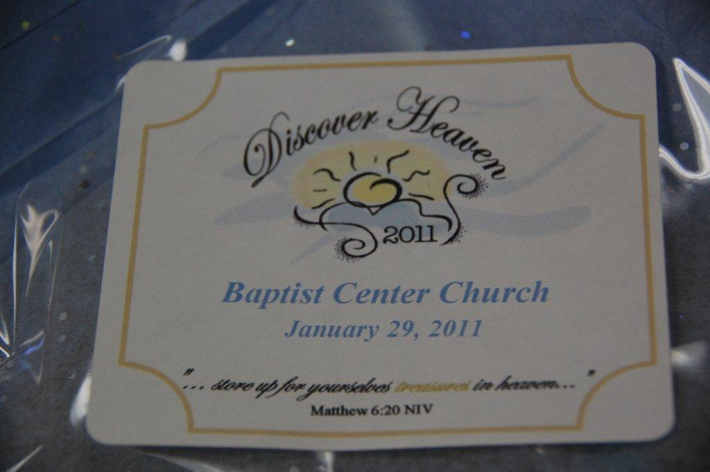

Slide 8
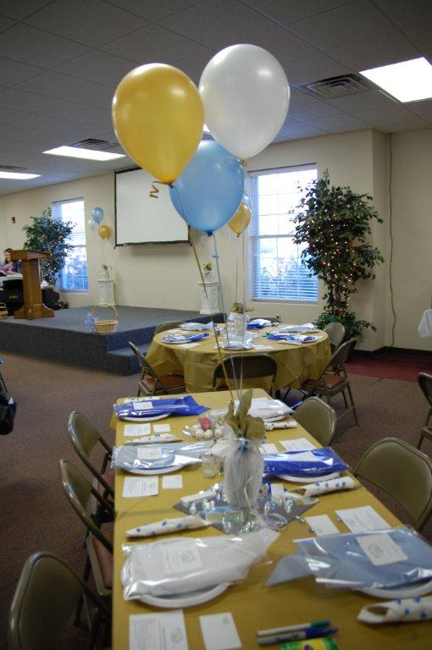

Slide 9
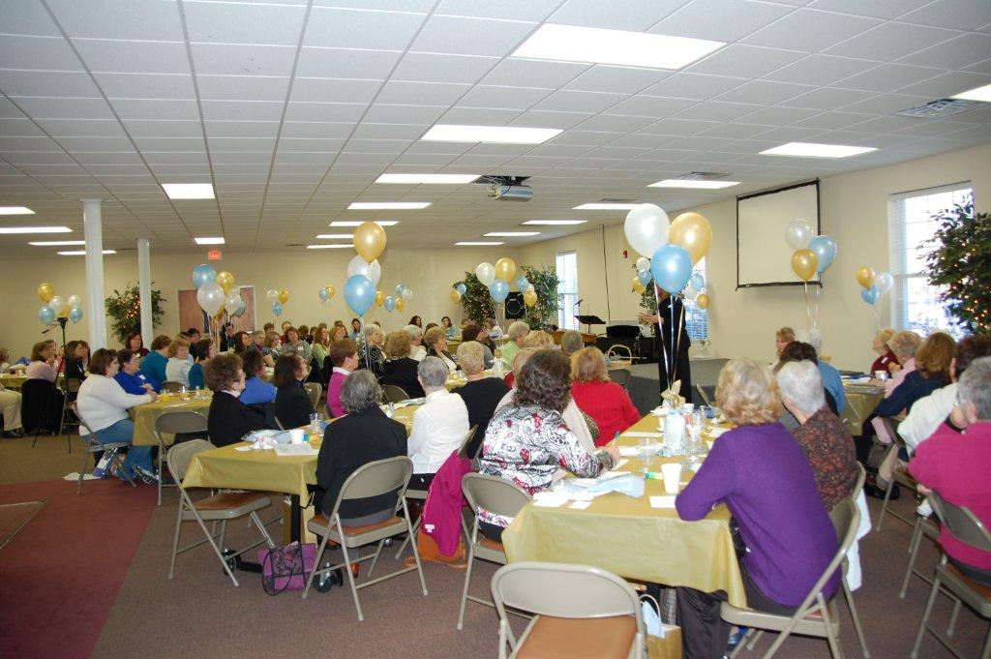

Slide 10
WMU loves…
RA’s, GA’s and Mission Friends

Slide 11
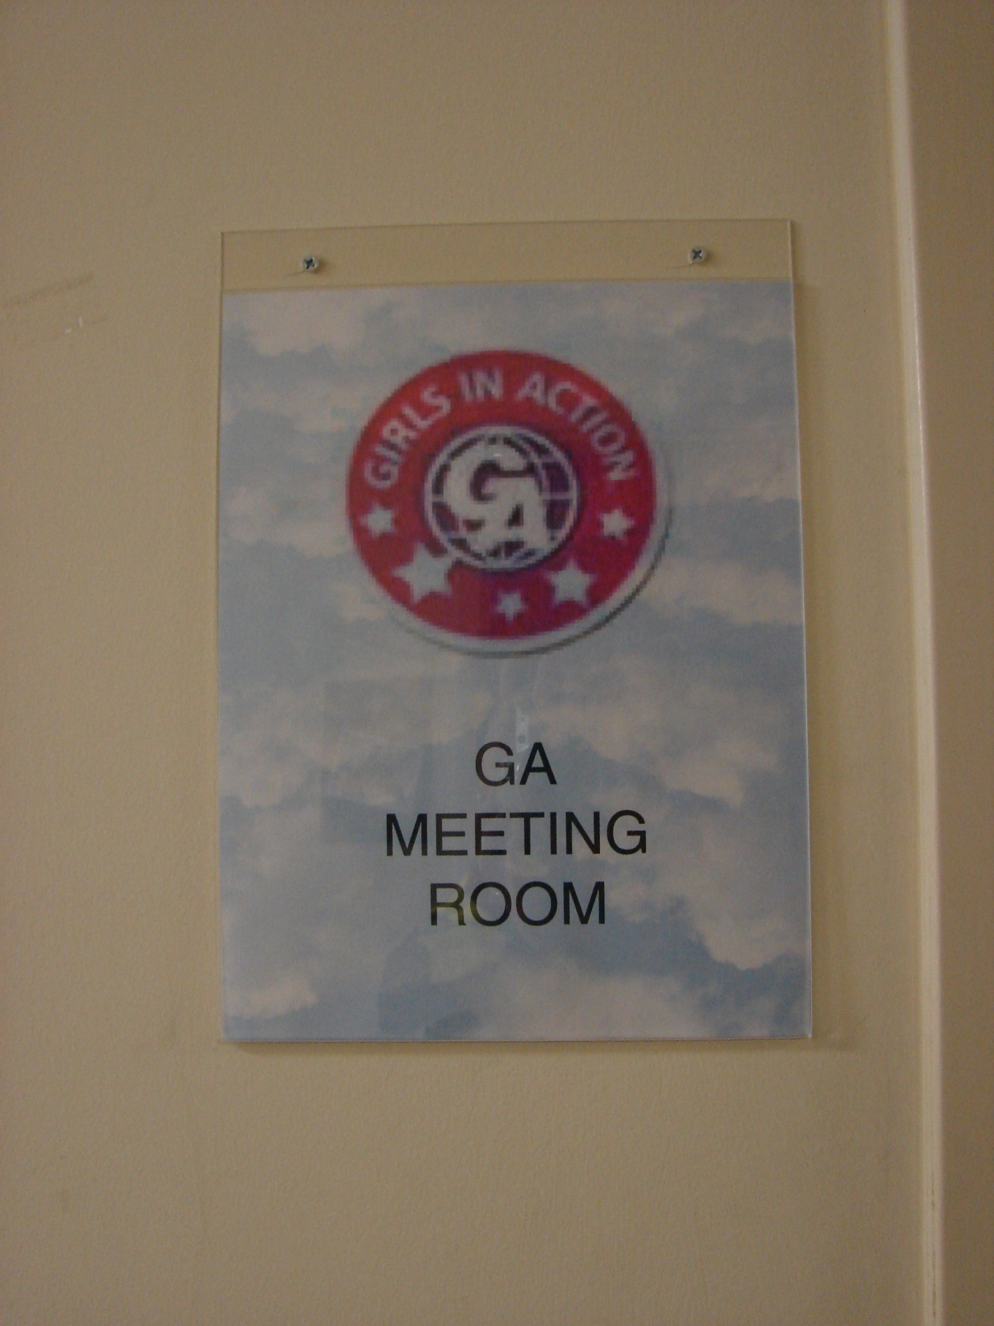

Slide 12
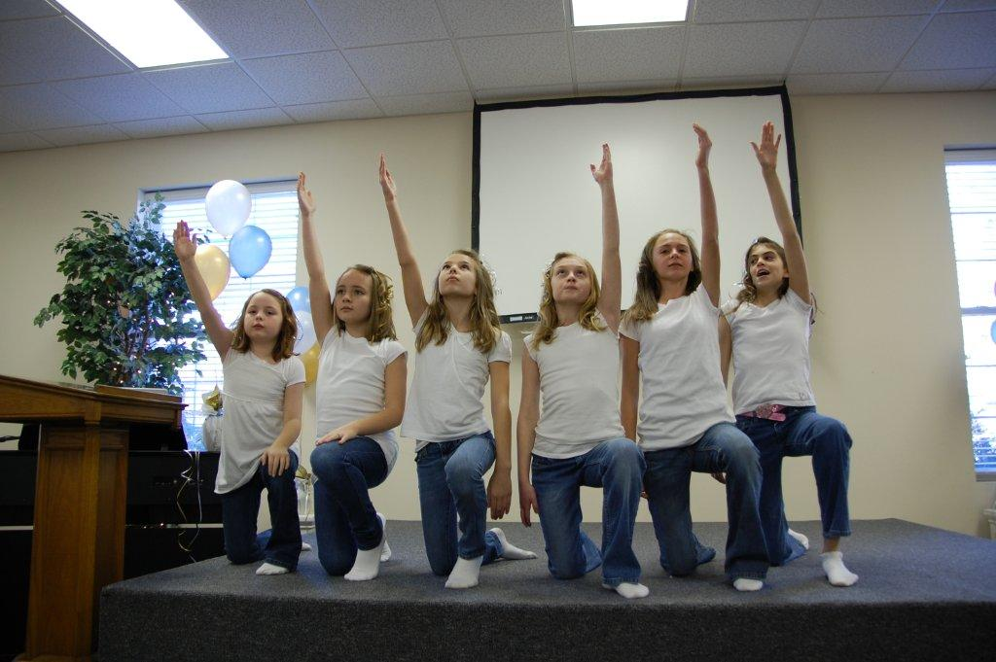

Slide 13
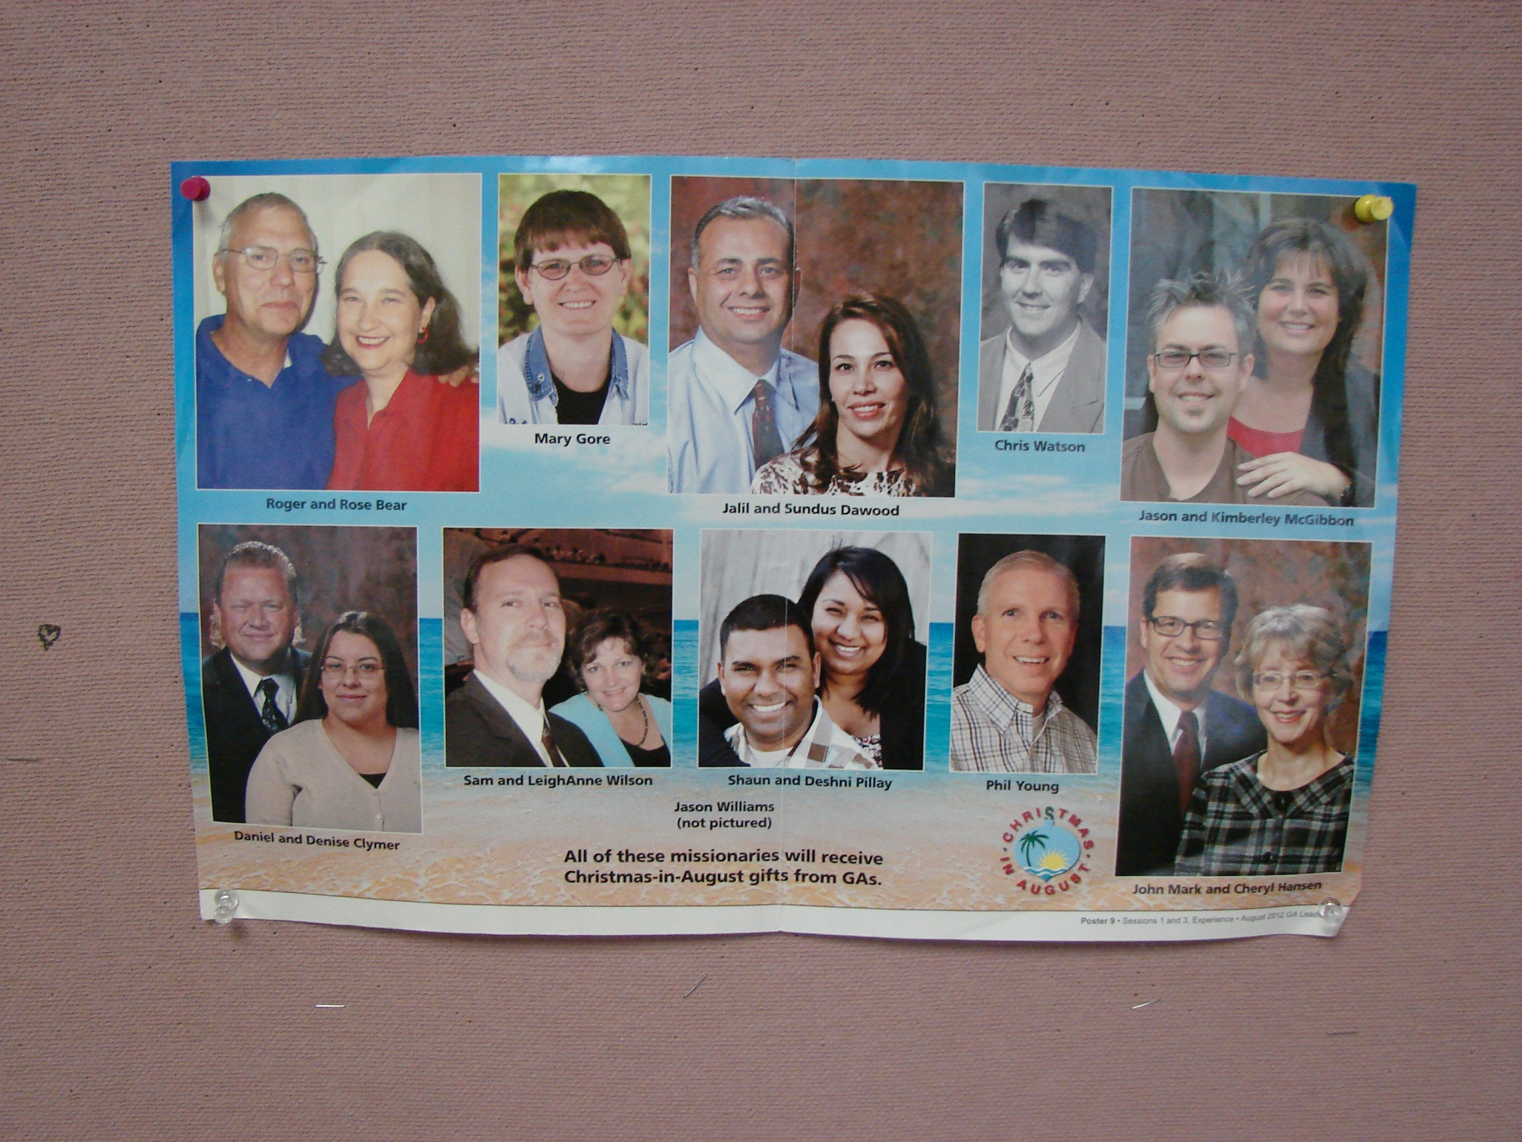

Slide 14
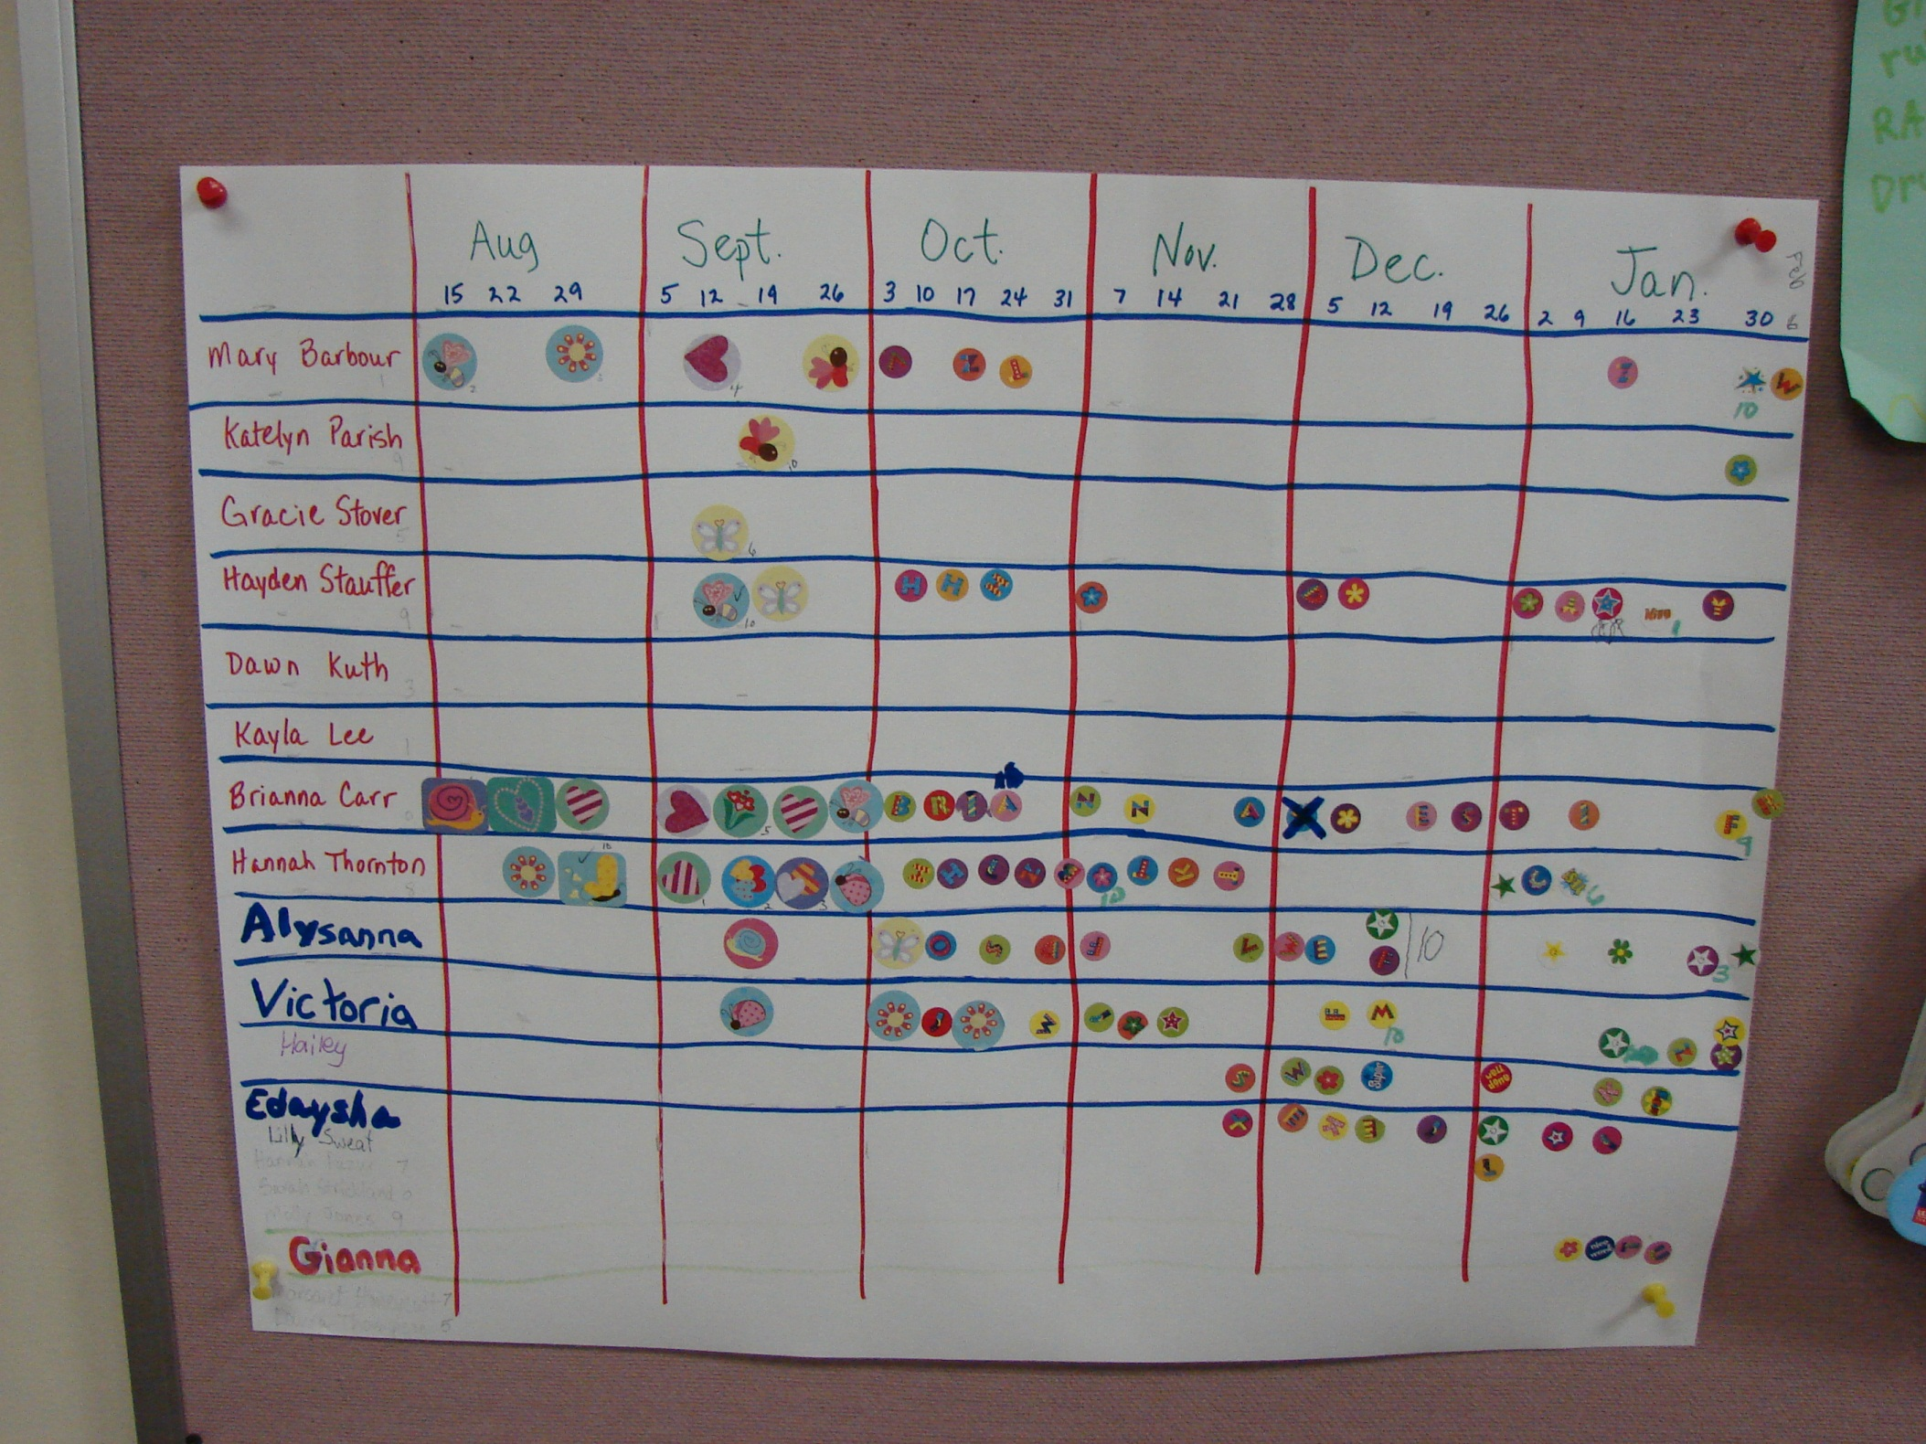

Slide 15
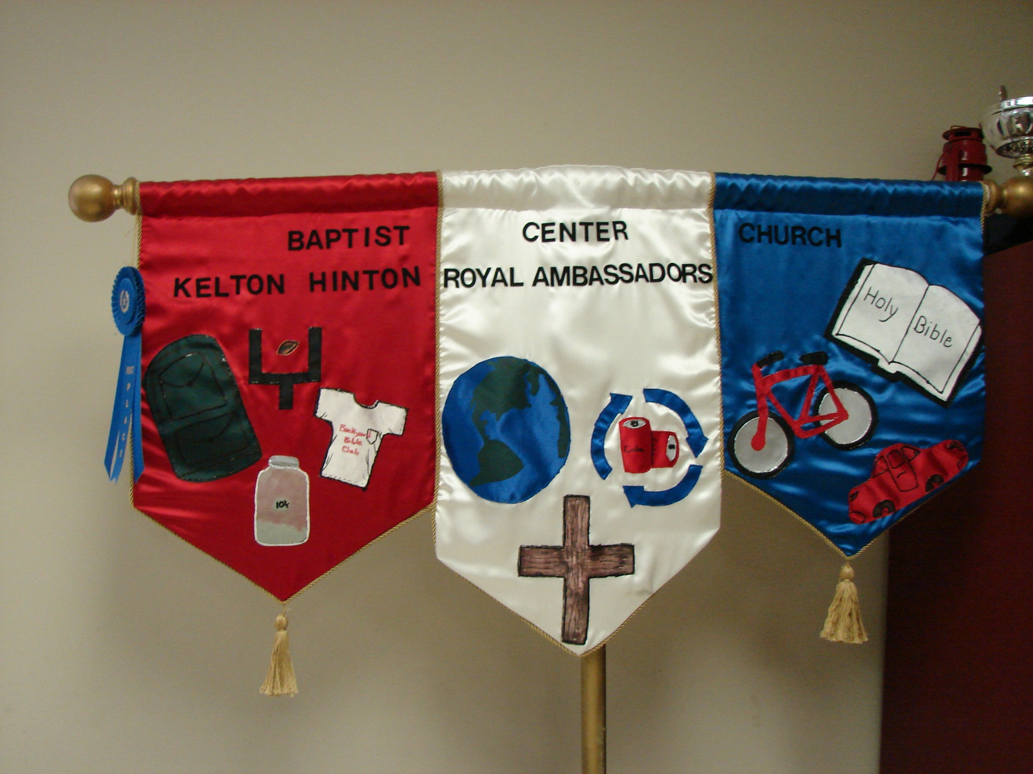

Slide 17
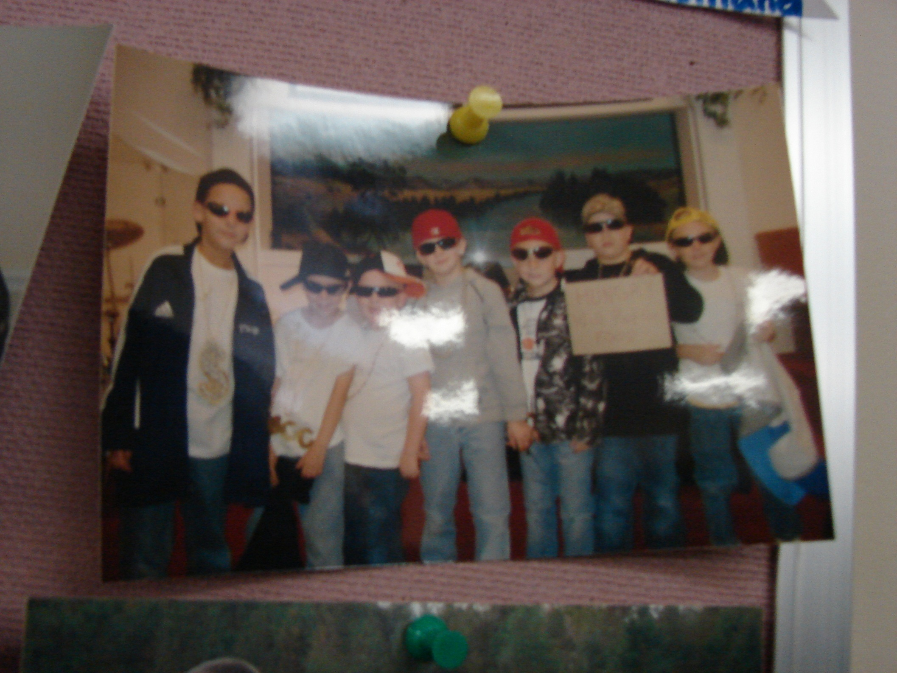

Slide 18
WMU loves…
Operation Christmas Child

Slide 19
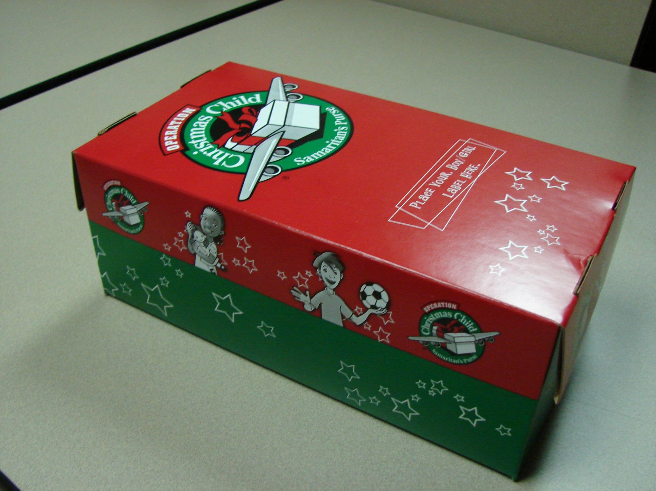

Slide 20
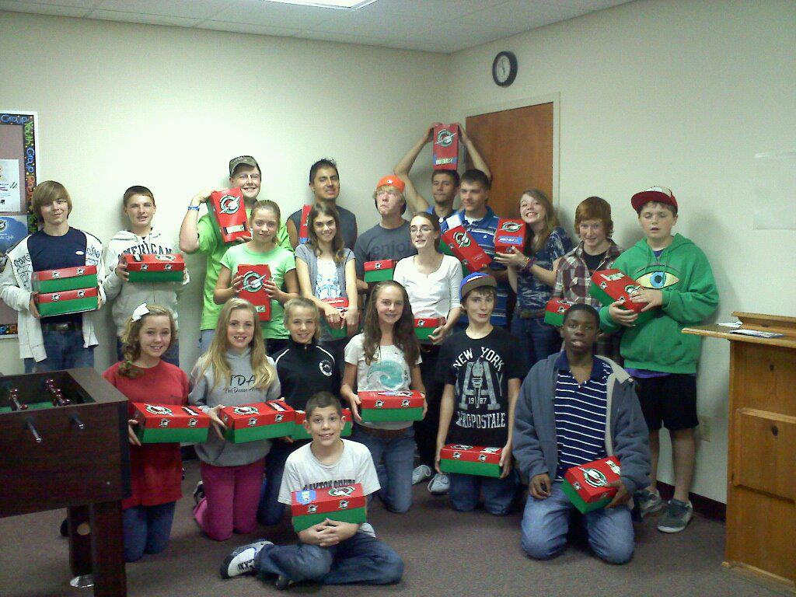

Slide 21
WMU loves…
Backyard Bible Clubs & VBS

Slide 22
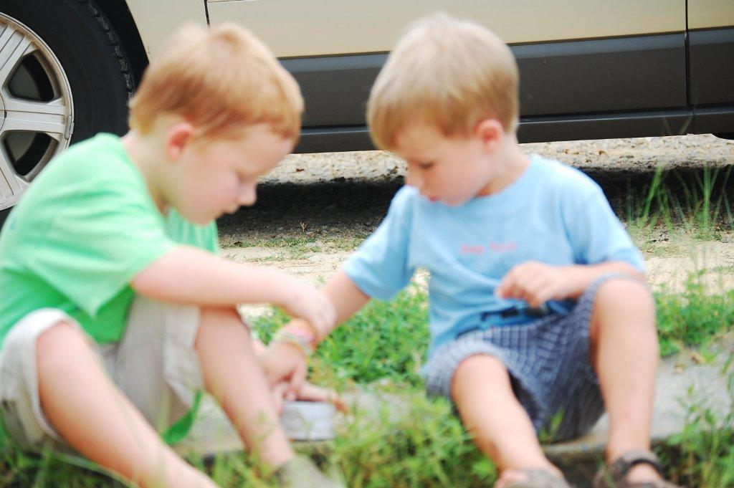

Slide 24
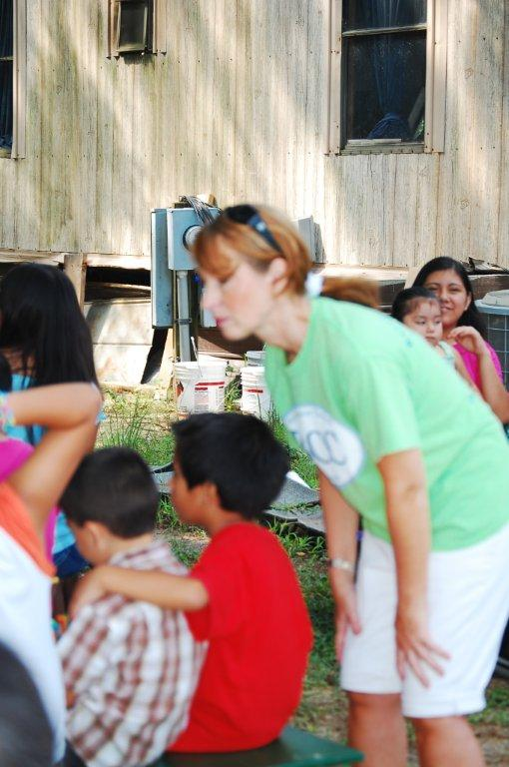

Slide 25
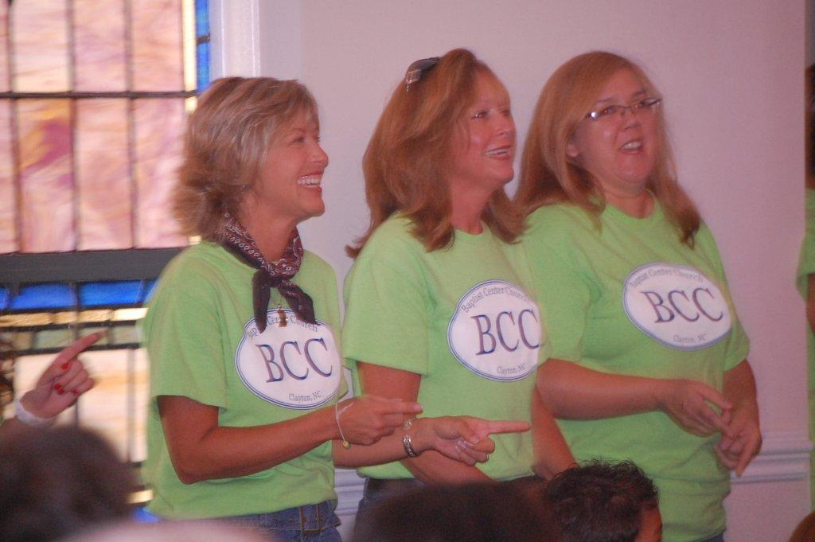

Slide 26
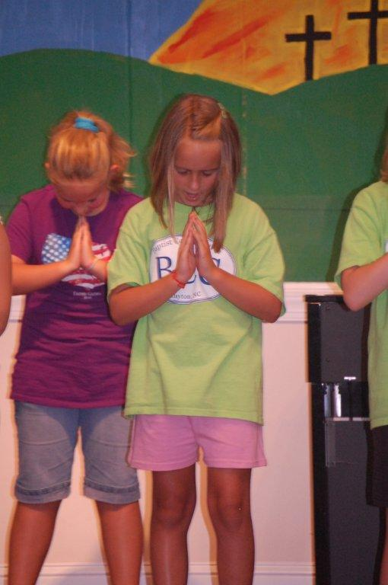

Slide 27
WMU loves…
Mission Offerings

Slide 30
WMU loves…
Hanging of the Green

Slide 31
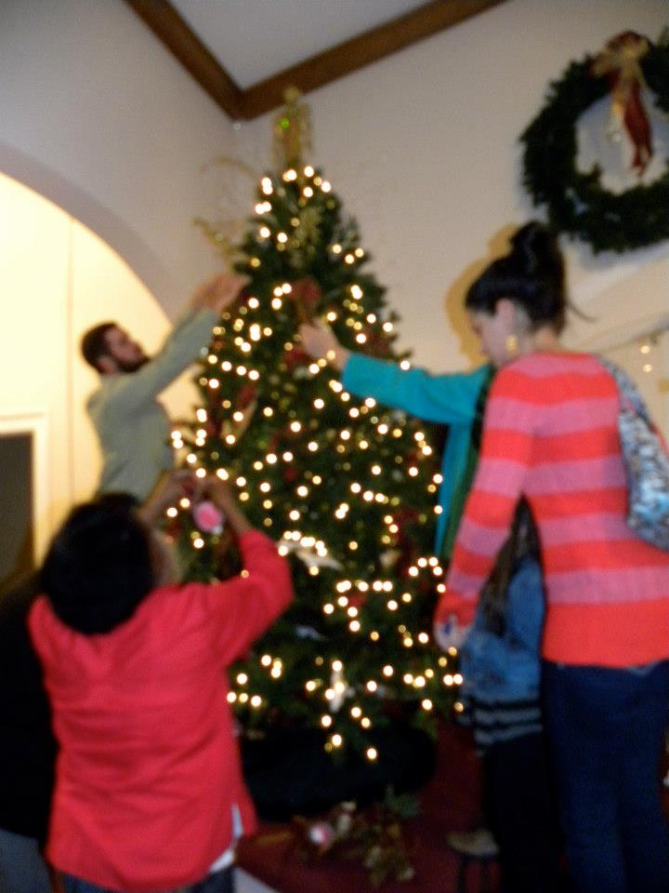

Slide 32
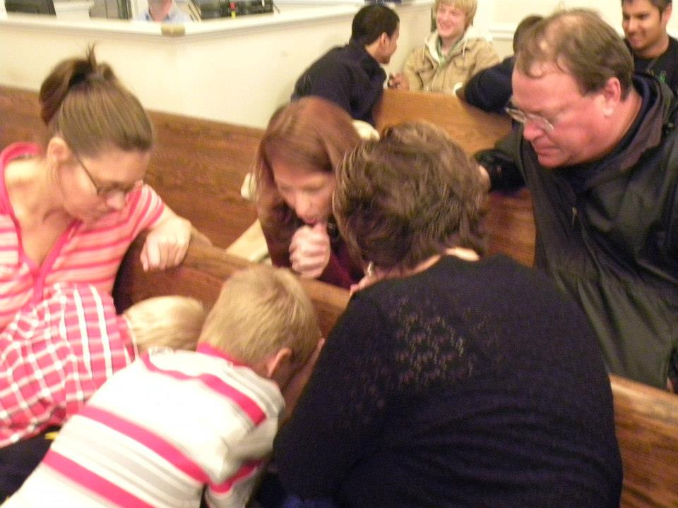

Slide 33
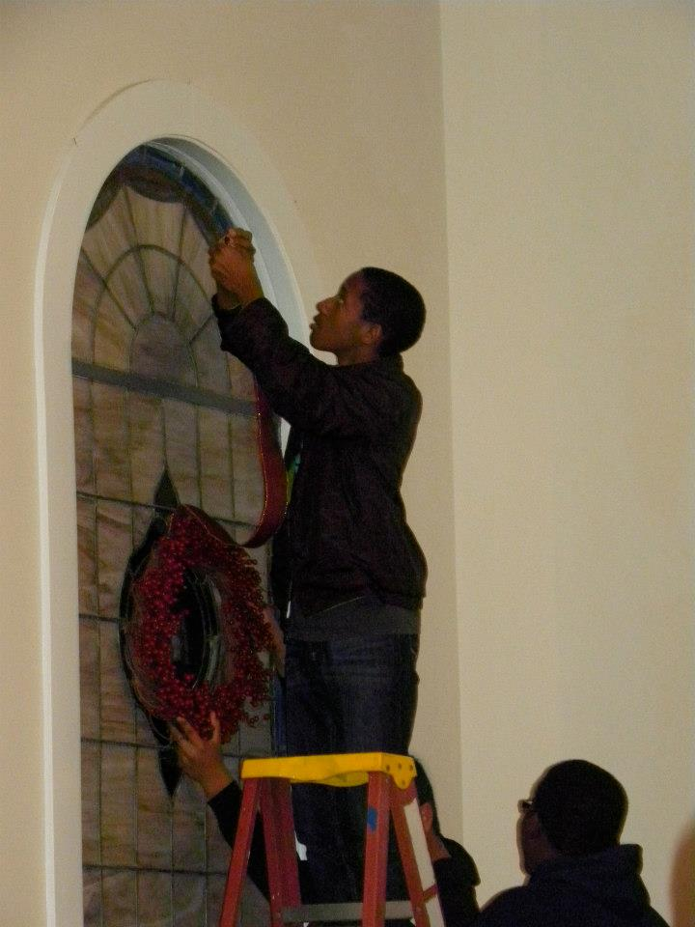

Slide 34
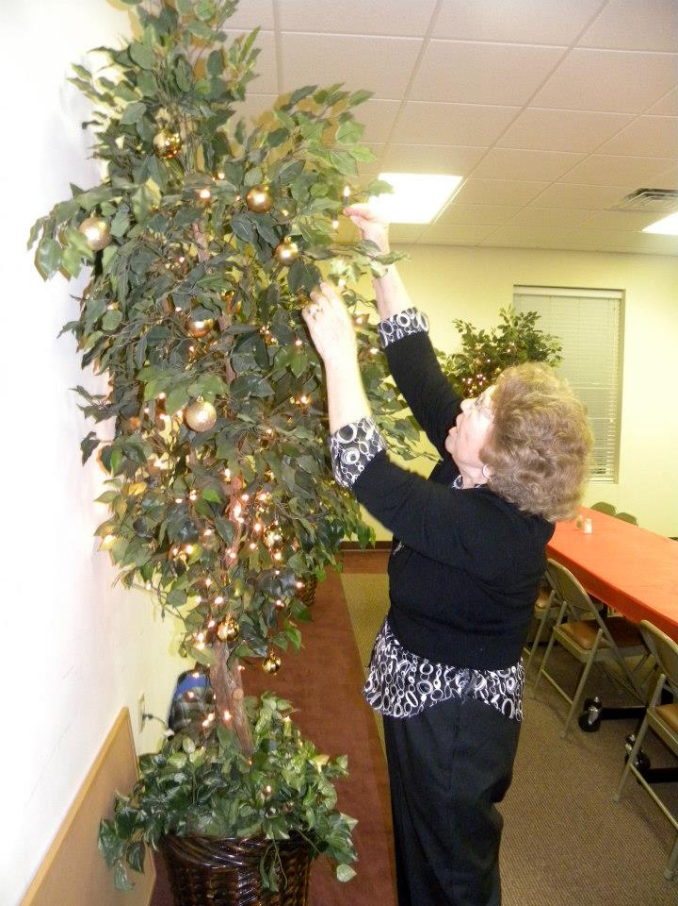

Slide 35
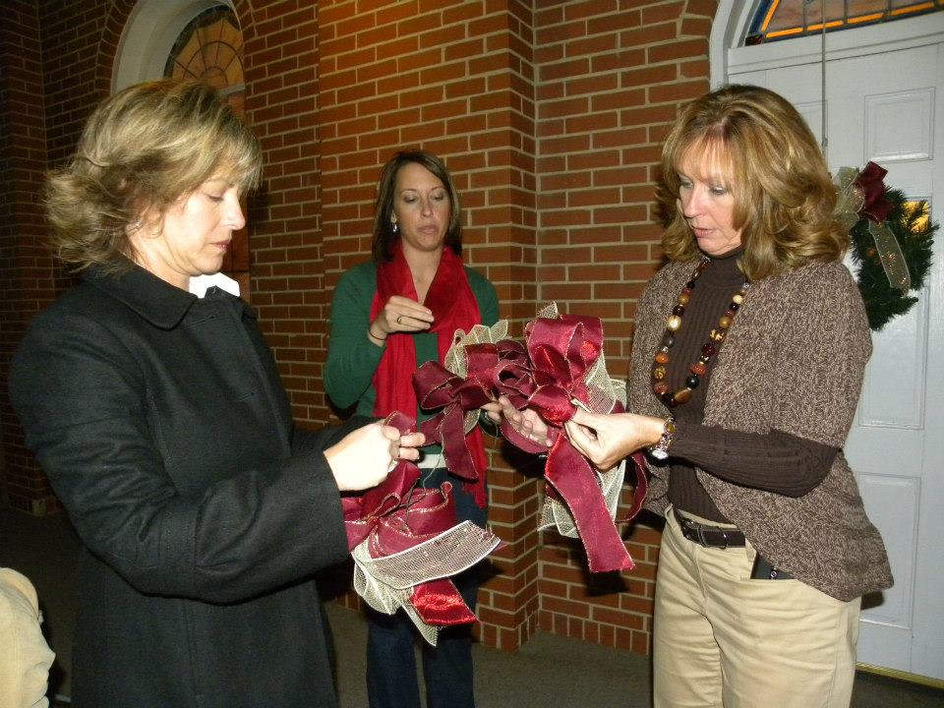

Slide 36
WMU loves…
Backpack Buddies

Slide 37
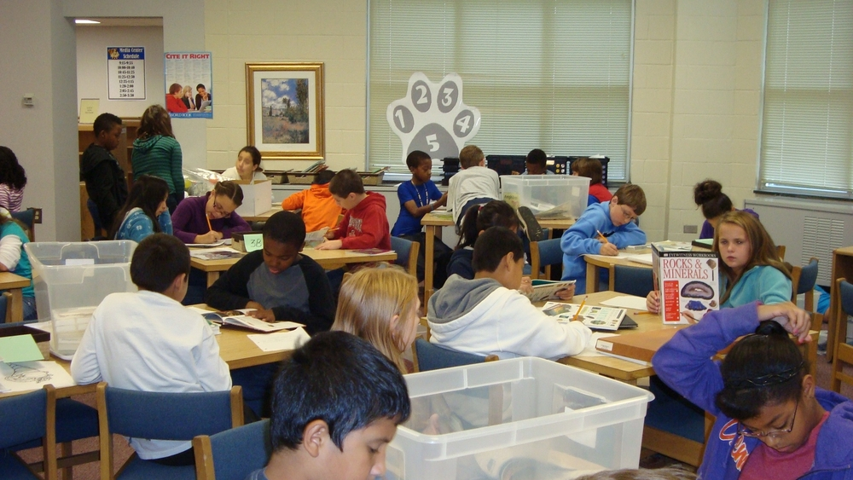

Slide 38
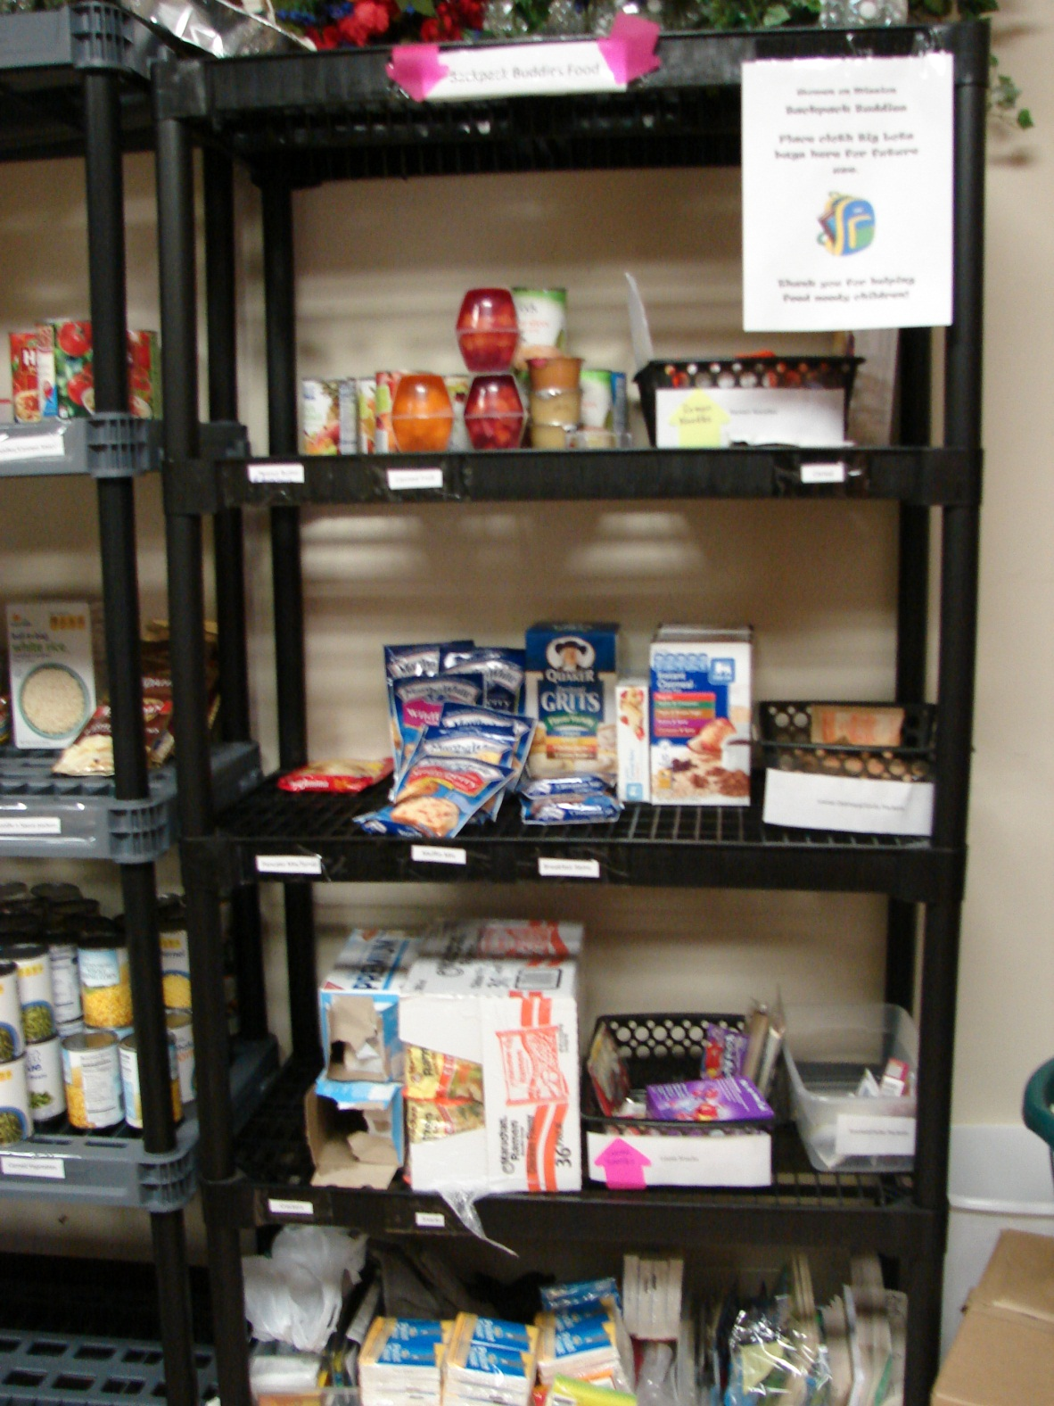

Slide 39
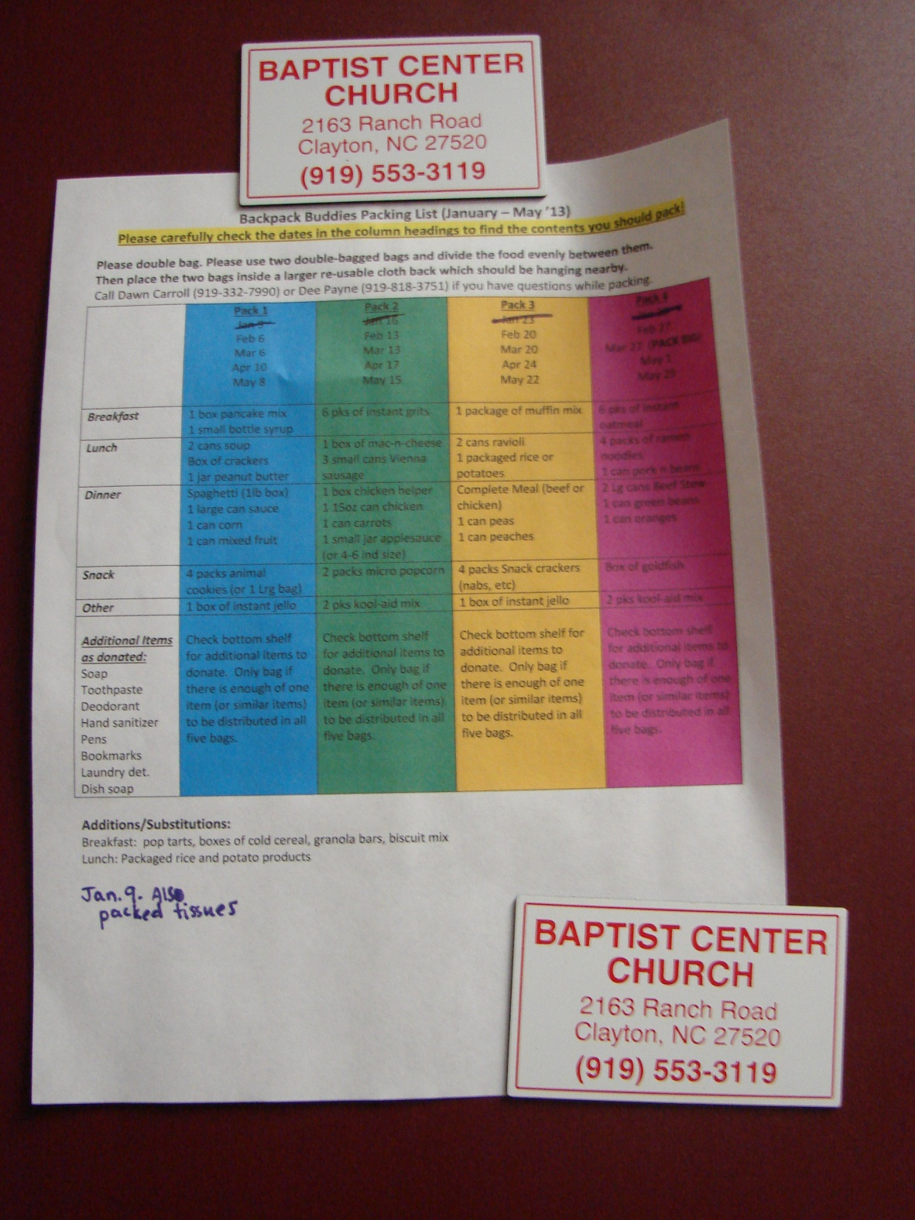

Slide 40
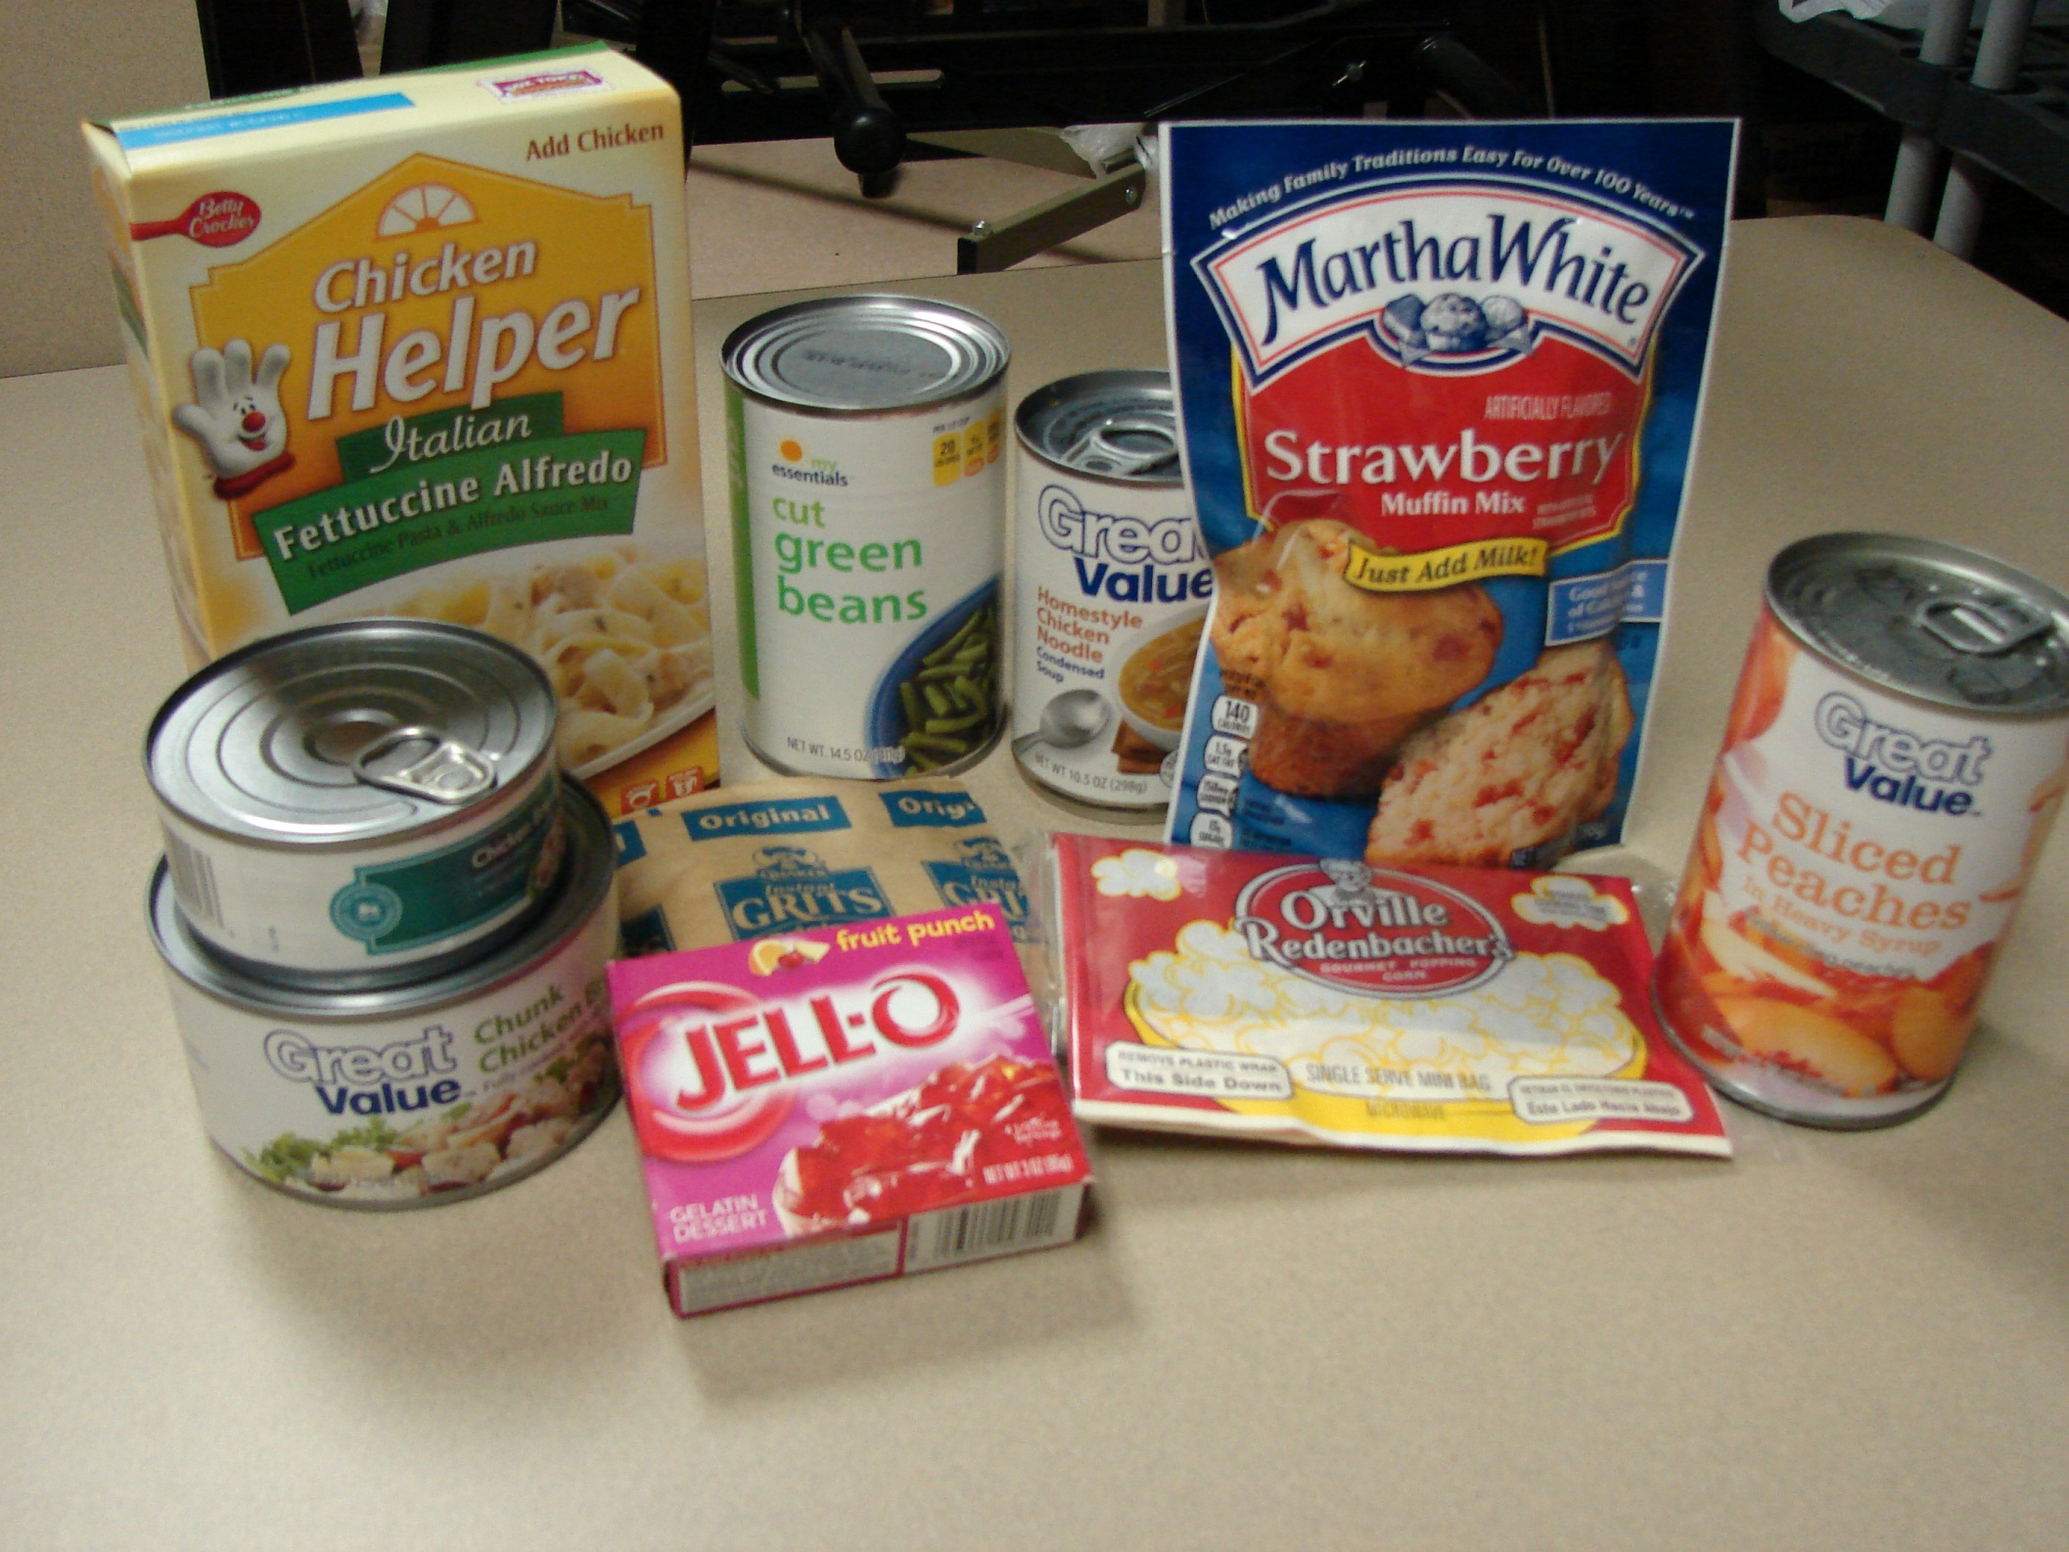

Slide 41
WMU loves…
Inreach & Outreach

Slide 42
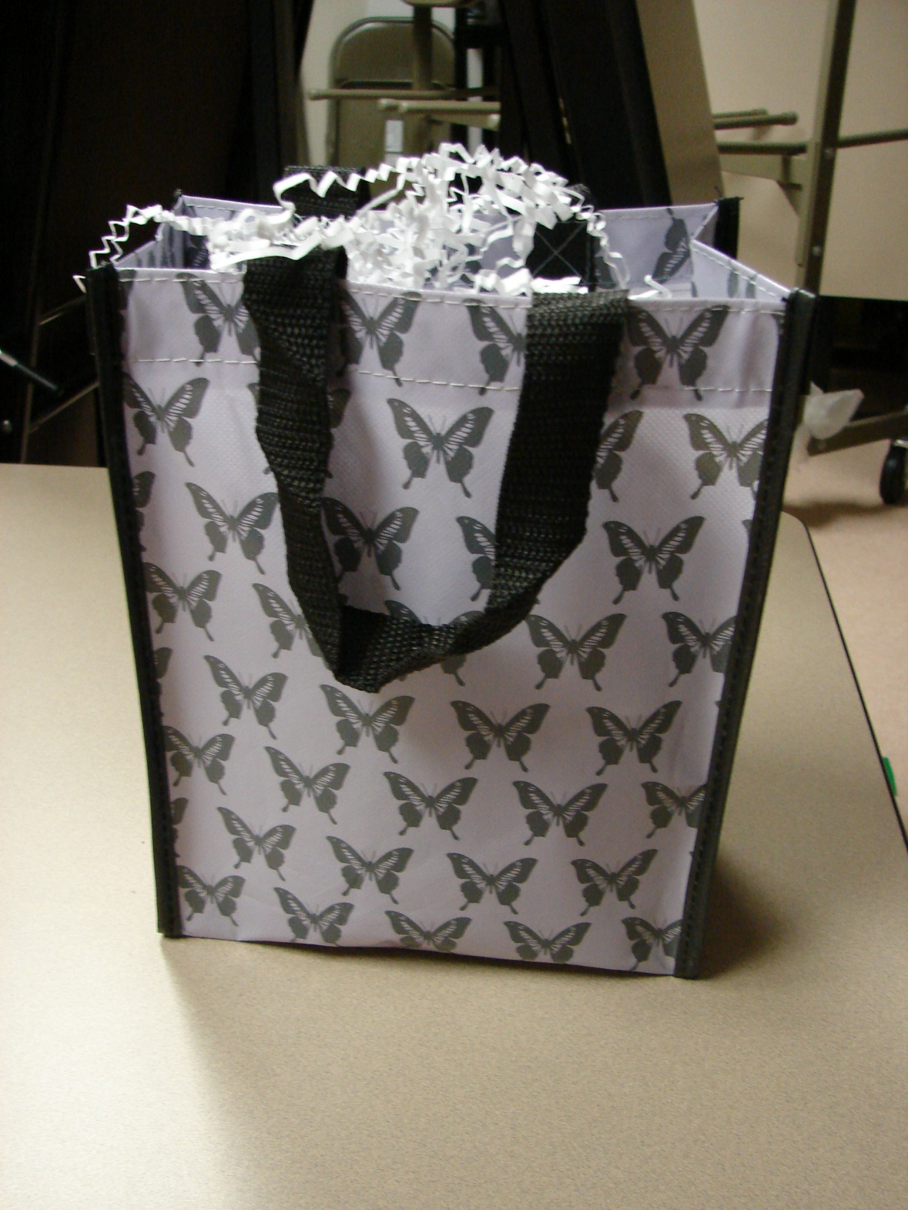

Slide 43
WMU loves…
Harbor Shelter

Slide 45
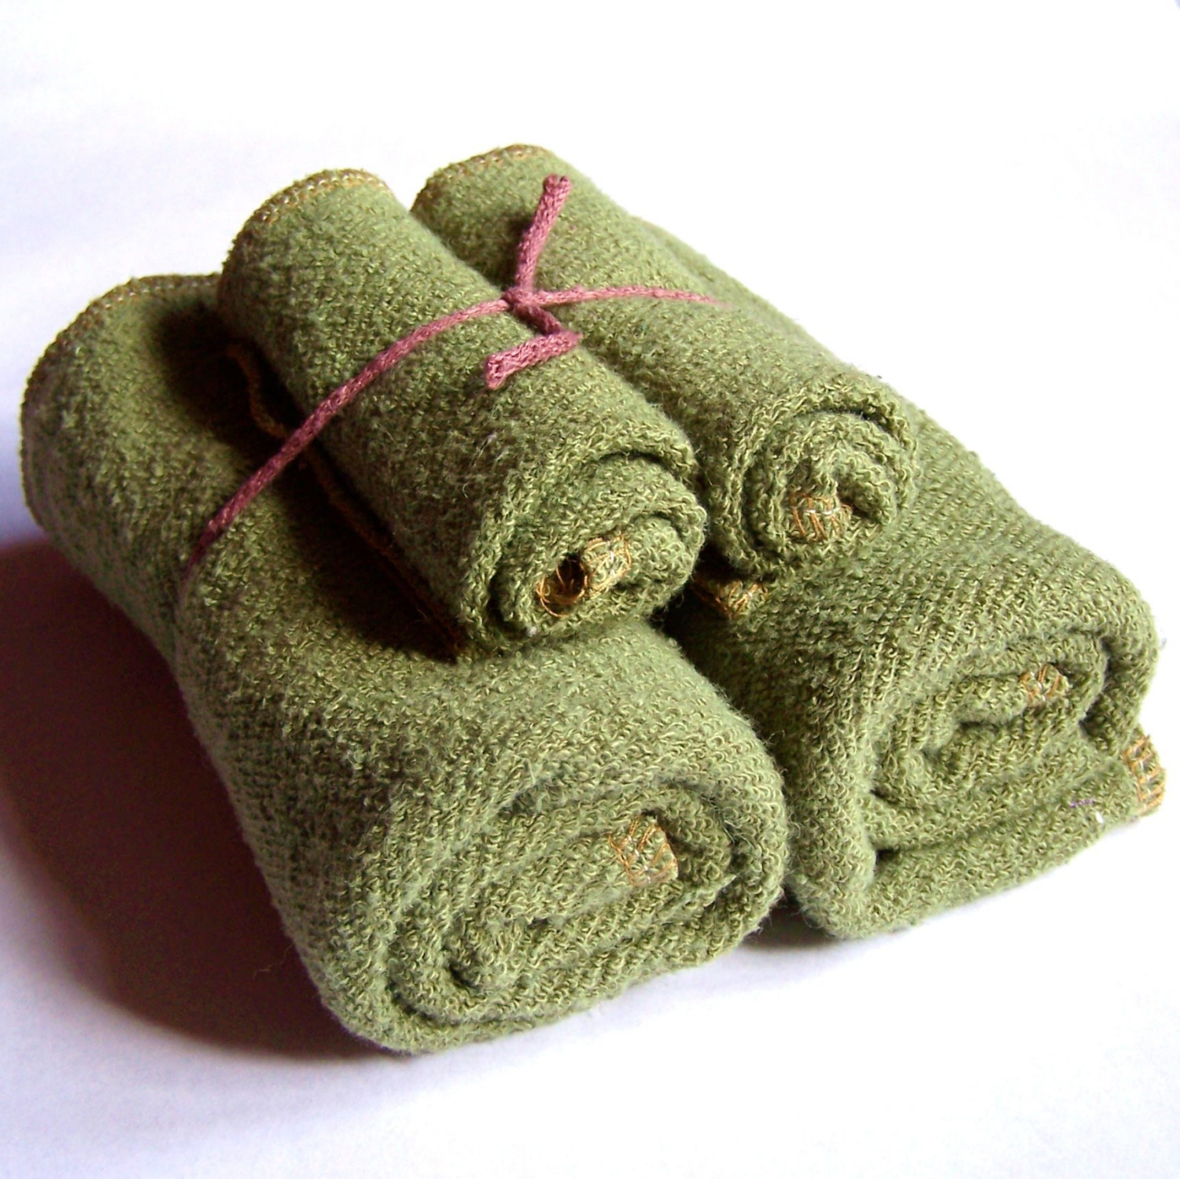

Slide 47
WMU loves…
Weddings

Slide 48
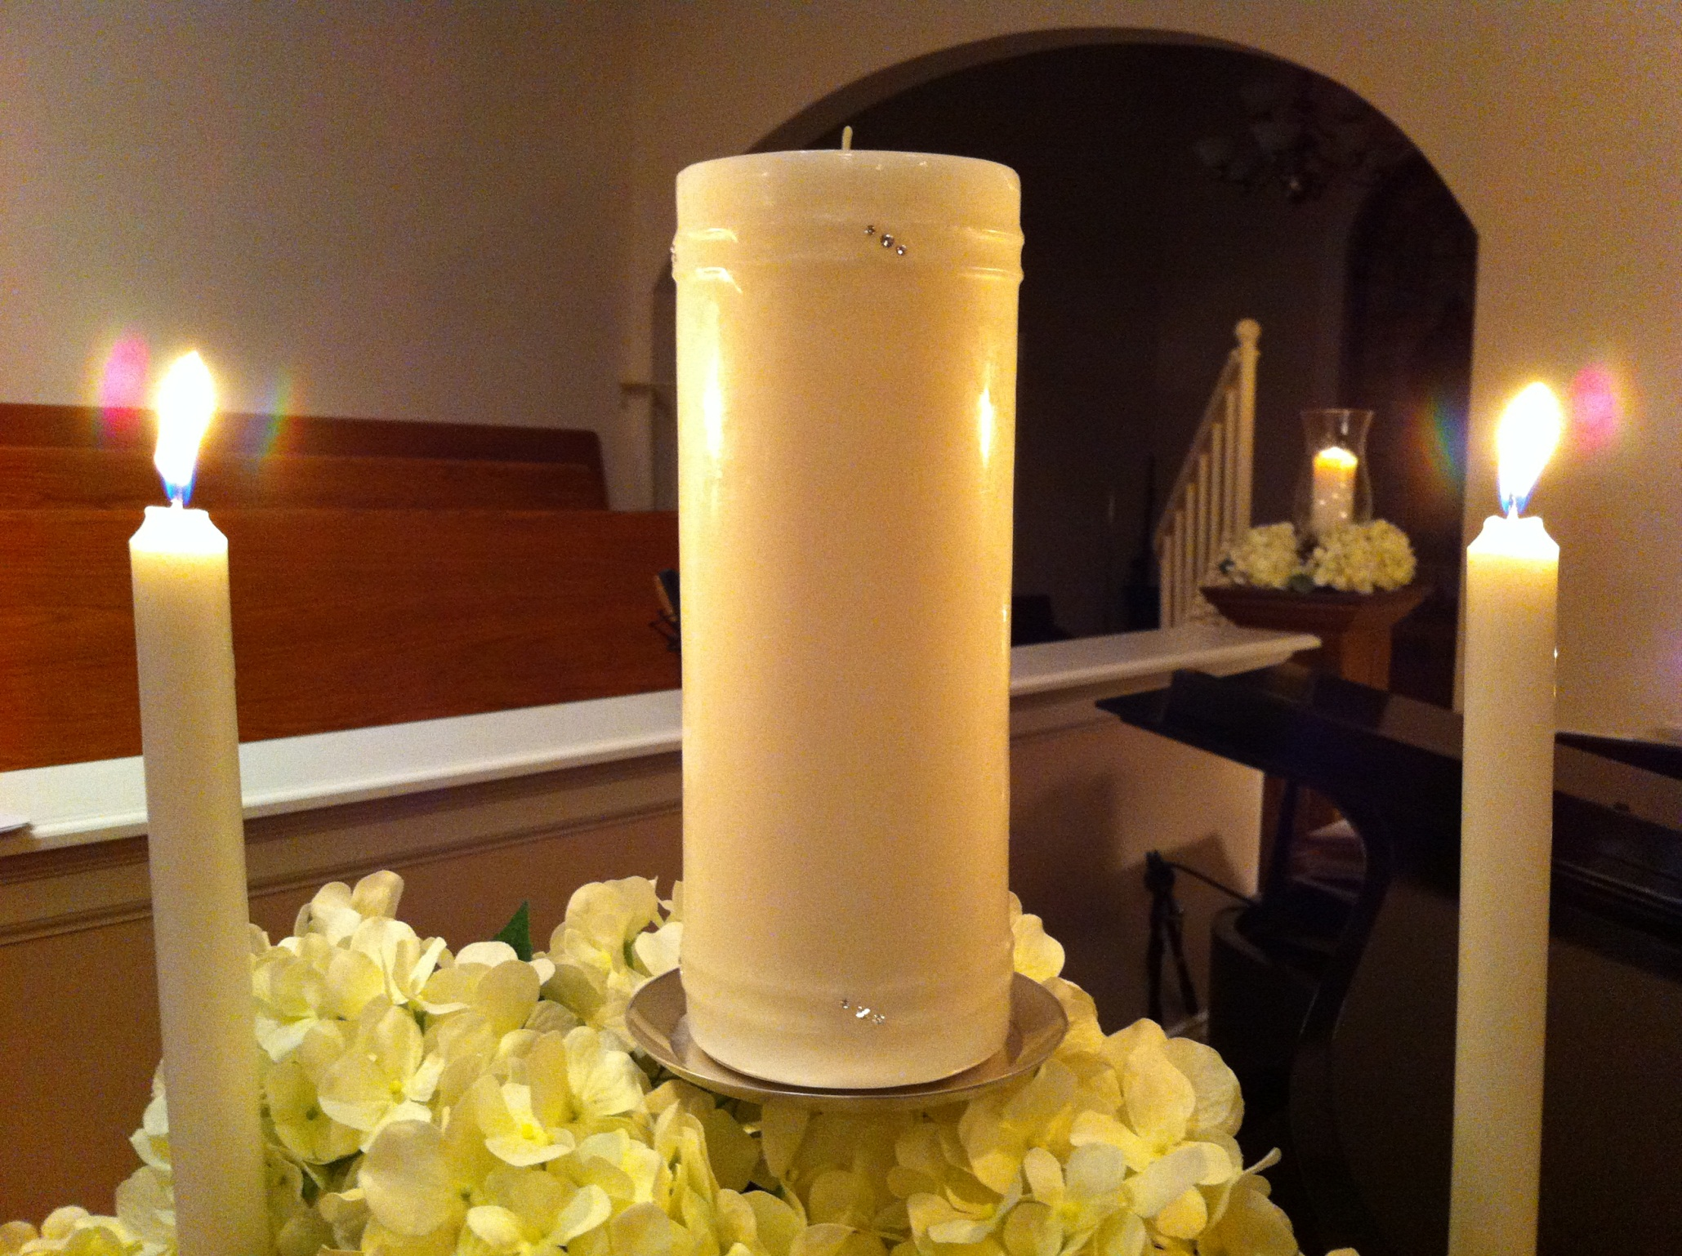

Slide 49
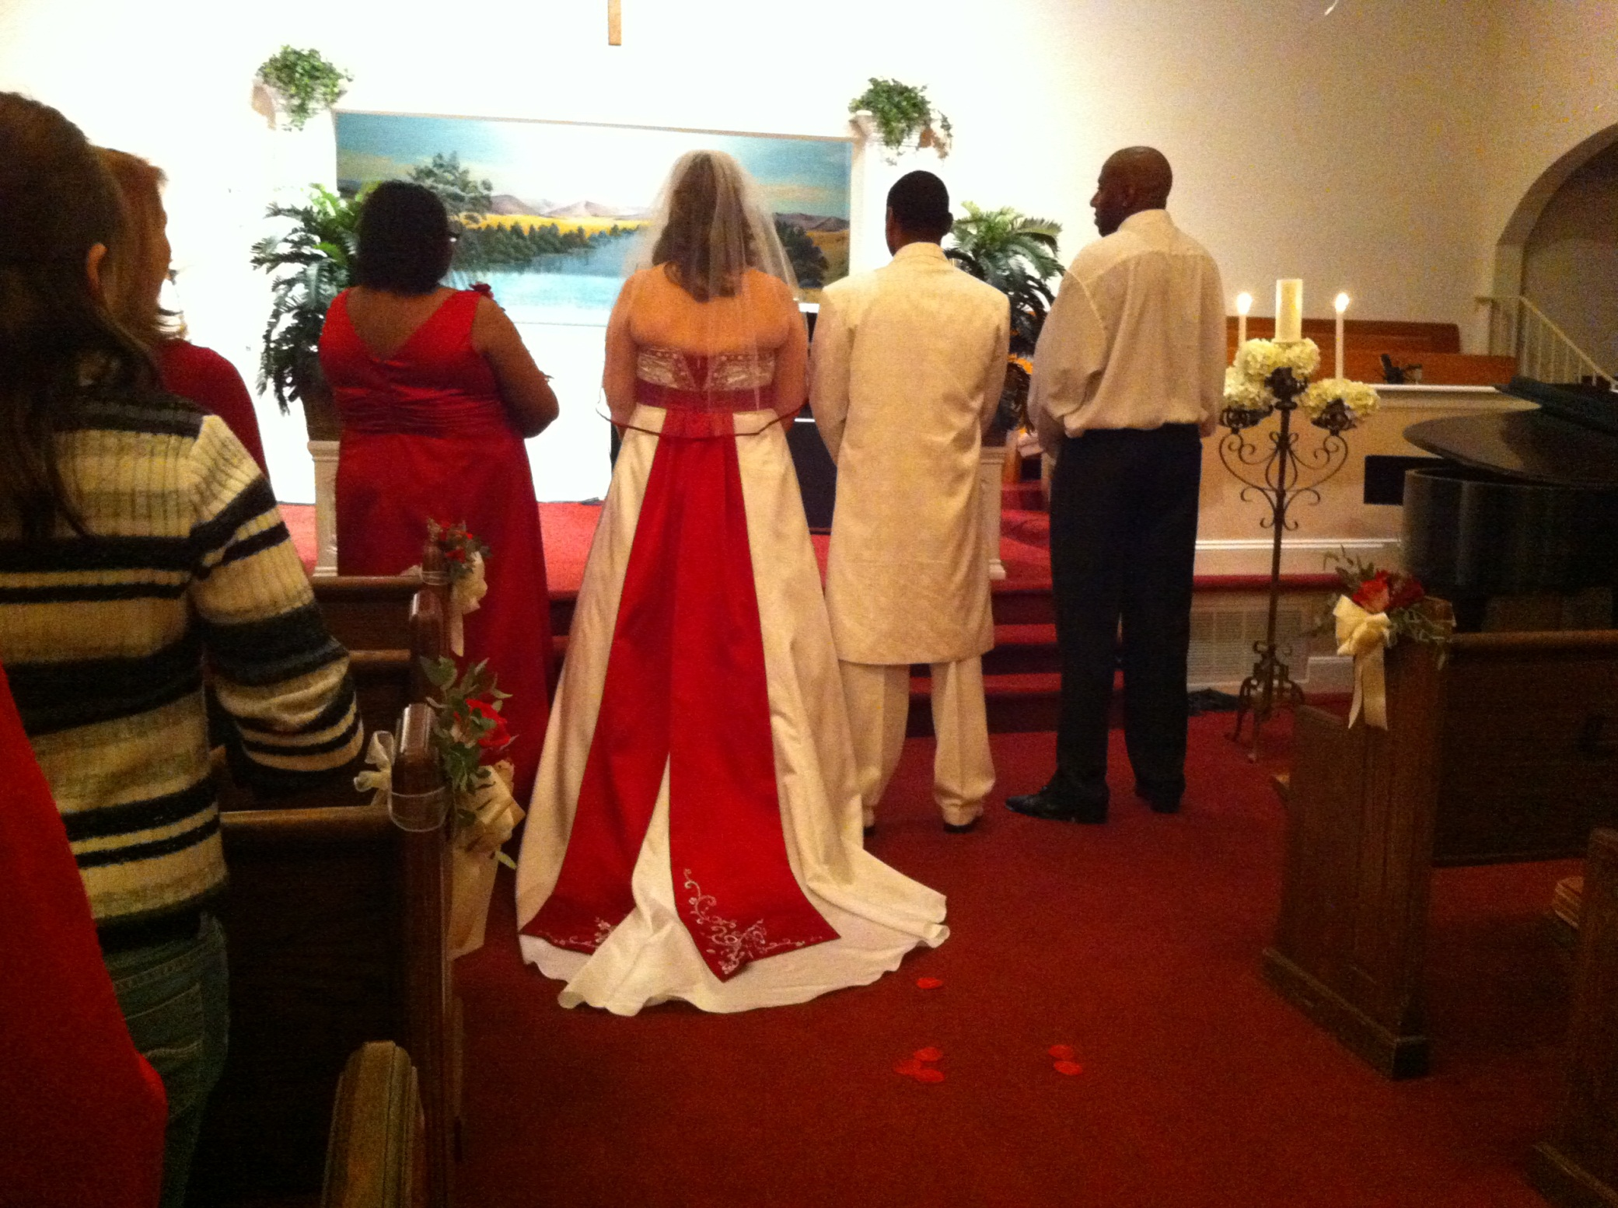

Slide 50
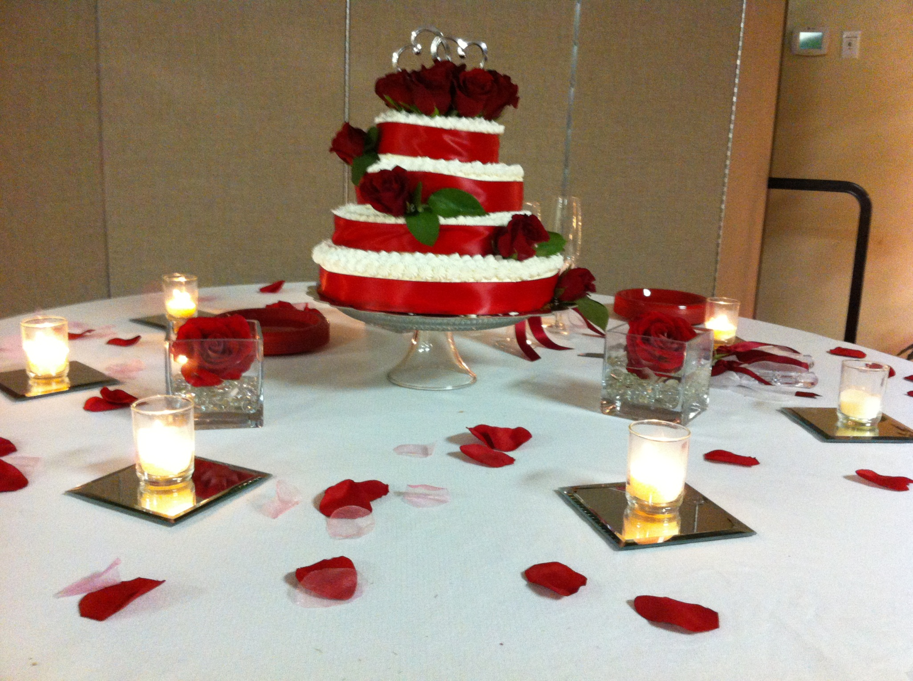

Slide 51
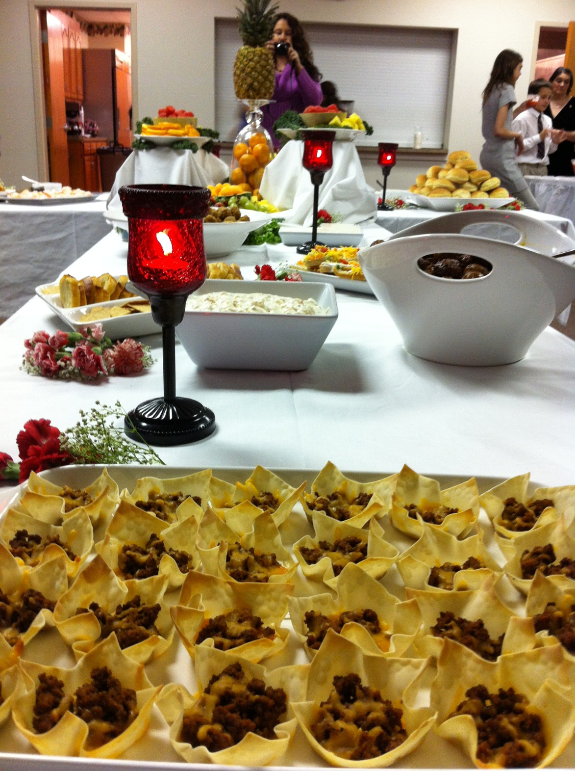

Slide 52
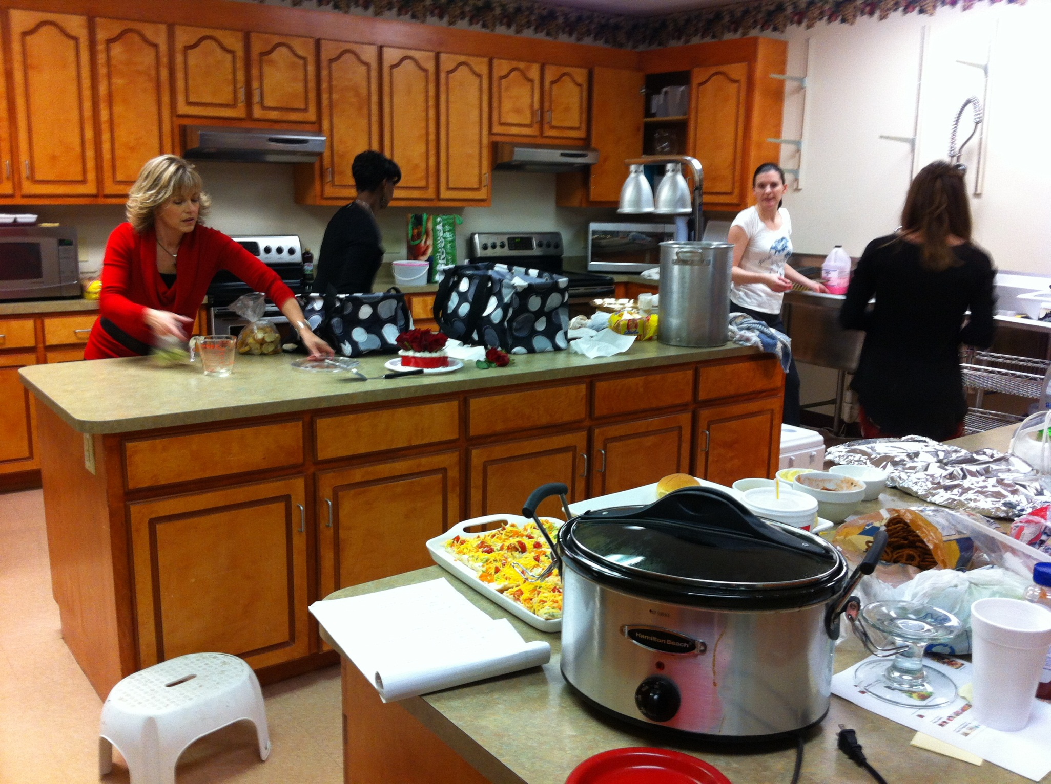

Slide 53
WMU loves…
iChoose Pregnancy Center

Slide 55
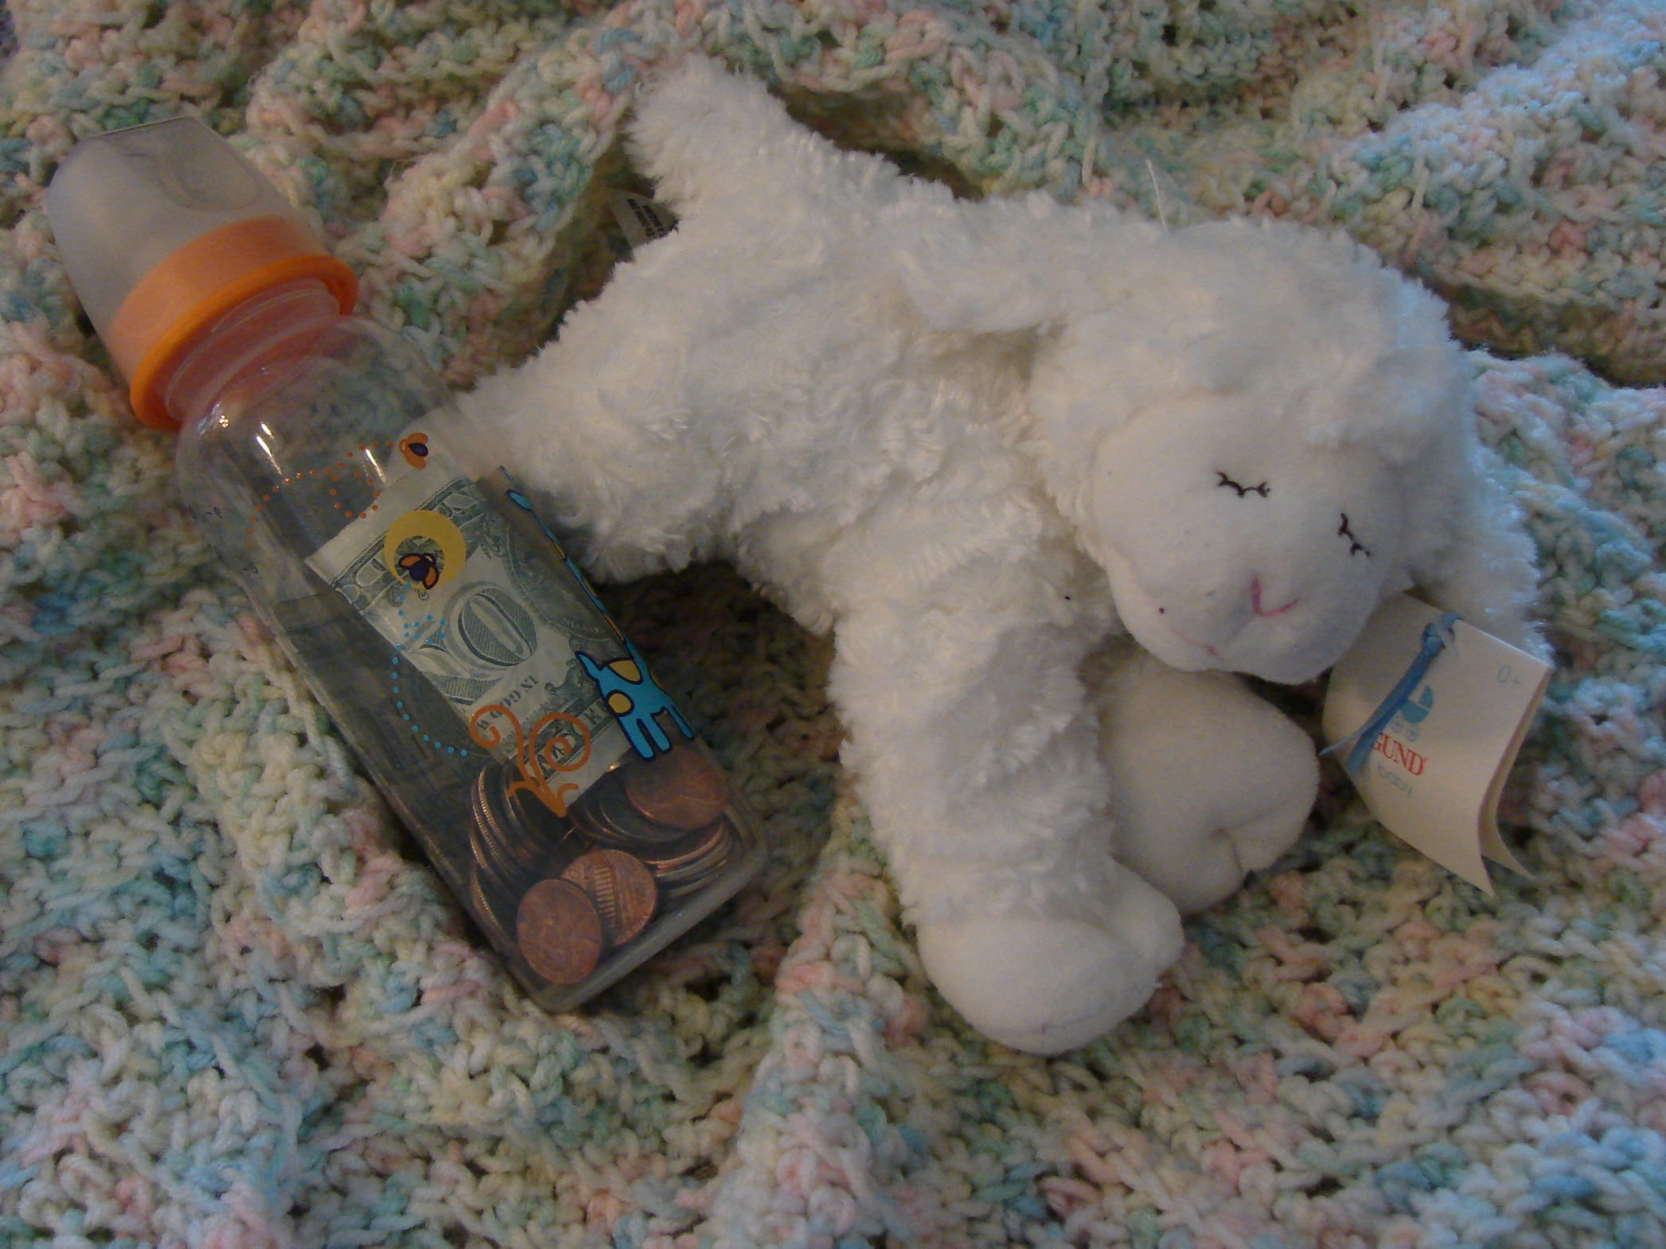

Slide 57
WMU loves…
Hardee Sisters’ Circle

Slide 58
WMU loves…
Learning about Missions

Slide 61
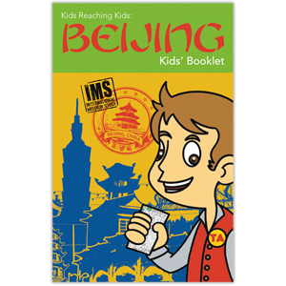

Slide 62
WMU loves…
Our Savior!

Slide 63
I John 4:19
We love
because
He first
loved us.

